Slide 1
TESTING

Slide 2
INTRODUCTION
It is the process used to identify the correctness, completeness and quality of developed computer software.
It is the process of executing a program/application under positive and negative conditions by manual or automated means. It checks for the :
Specification
Functionality
Performance

Slide 3
OBJECTIVES
Uncover as many as errors (or bugs) as possible in a given product.
Demonstrate a given software product matching its requirement specifications.
Validate the quality of a software testing using the minimum cost and efforts.
Generate high quality test cases, perform effective tests, and issue correct and helpful problem reports.

Slide 4
Error, Bug, Fault & Failure
Error : It is a human action that produces the incorrect result that produces a fault.
Bug : The presence of error at the time of execution of the software.
Fault : State of software caused by an error.
Failure : Deviation of the software from its expected result. It is an event.

Slide 5
SDLC
Standard model used word wide to develop a software.
A framework that describes the activities performed at each stage of a software development project.
Necessary to ensure the quality of the software.
Logical steps taken to develop a software product.

Slide 6
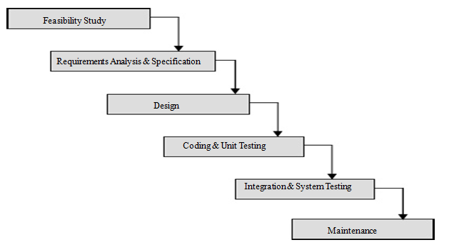
Classical Waterfall Model

Slide 7
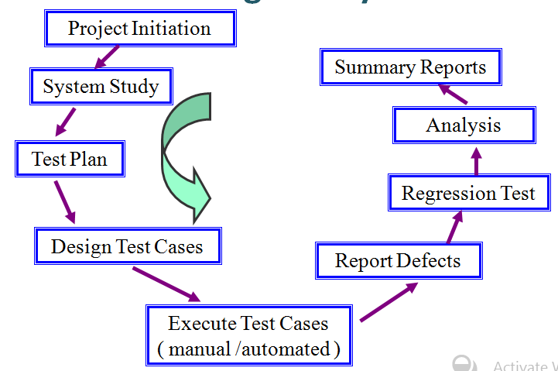
Testing Life Cycle

Slide 8
Test Plan:
It is a systematic approach to test a system i.e. software. The plan typically contains a detailed understanding of what the eventual testing workflow will be.
Test Case:
It is a specific procedure of testing a particular requirement.
It will include:
Identification of specific requirement tested
Test case success/failure criteria
Specific steps to execute test
Test data

Slide 9
Verification vs Validation
Verification: The software should confirm to its specification (Are we building the product right?)
Validation: The software should do what the user really requires (Are we building the right product?)

Slide 10
Testing Methodology
Black Box Testing
No knowledge of internal program design or code required.
Tests are based on requirements and functionality.
White Box Testing
Knowledge of the internal program design and code required.
Tests are based on coverage of code statements, branches, paths, conditions.

Slide 11
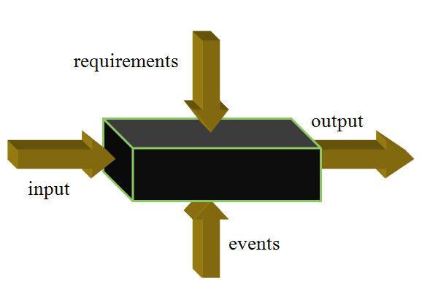
Black Box Testing

Slide 12
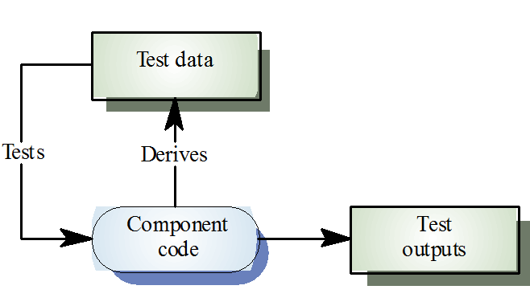
White Box Testing

Slide 13
Testing Levels
Unit testing
Integration testing
System testing

Slide 14
UNIT TESTING
Tests each module individually.
Follows a white box testing (Logic of the program).
Done by developers.

Slide 15
INTEGRATION TESTING
Once all the modules have been unit tested, integration testing is performed.
It is systematic testing.
Produce tests to identify errors associated with interfacing.
Types:
Big Bang Integration testing
Top Down Integration testing
Bottom Up Integration testing
Mixed Integration testing

Slide 16
Bottom-Up Integration
Only terminal modules (i.e., the modules that do not call other modules) are tested in isolation
Modules at lower levels are tested using the previously tested higher level modules
Non-terminal modules are not tested in isolation
Requires a module driver for each module to feed the test case input to the interface of the module being tested
However, stubs are not needed since we are starting with the terminal modules and use already tested modules when testing modules in the lower levels

Slide 17
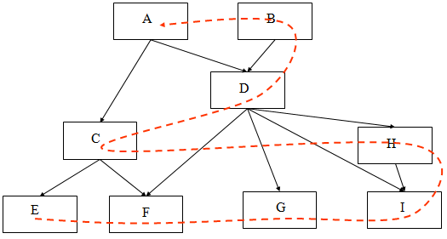
Bottom-Up Integration

Slide 18
Top-down Integration
Only modules tested in isolation are the modules which are at the highest level
After a module is tested, the modules directly called by that module are merged with the already tested module and the combination is tested
Requires stub modules to simulate the functions of the missing modules that may be called
However, drivers are not needed since we are starting with the modules which is not used by any other module and use already tested modules when testing modules in the higher levels

Slide 19
Top-down Integration
A
B
D
C
H
E
F
G
I

Slide 20
Other Approaches to Integration
Sandwich Integration
Compromise between bottom-up and top-down testing
Simultaneously begin bottom-up and top-down testing and meet at a predetermined point in the middle
Big Bang Integration
Every module is unit tested in isolation
After all of the modules are tested they are all integrated together at once and tested
No driver or stub is needed
However, in this approach, it may be hard to isolate the bugs!

Slide 21
SYSTEM TESTING
The system as a whole is tested to uncover requirement errors.
Verifies that all system elements work properly and that overall system function and performance has been achieved.
Types:
Alpha Testing
Beta Testing
Acceptance Testing
Performance Testing

Slide 22
Alpha Testing
It is carried out by the test team within the developing organization .
Beta Testing
It is performed by a selected group of friendly customers.
Acceptance Testing
It is performed by the customer to determine whether to accept or reject the delivery of the system.
Performance Testing
It is carried out to check whether the system meets the nonfunctional requirements identified in the SRS document.

Slide 23
Types of Performance Testing:
Stress Testing
Volume Testing
Configuration Testing
Compatibility Testing
Regression Testing
Recovery Testing
Maintenance Testing
Documentation Testing
Usability Testing

Slide 24
DISCUSSION
In order to be cost effective, the testing must be concentrated on areas where it will be most effective.
The testing should be planned such that when testing is stopped for whatever reason, the most effective testing in the time allotted has already been done.
The absence of an organizational testing policy may result in too much effort and money will be spent on testing, attempting to achieve a level of quality that is impossible or unnecessary.

Slide 25
THANK YOU

